Slide 1
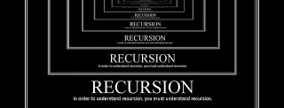
Recursion
Using Recursion, Recursion vs Iteration
SoftUni Team
Technical Trainers
Software University
https://about.softuni.bg/

Slide 2
Table of Contents
Recursion
A function calls itself
Recursion or Iteration?
Harmful Recursion and Optimizing Bad Recursion
2

Slide 3

What is Recursion?

Slide 4

What is Recursion?
A function or a method that calls itself one or more times until a specified condition is met
After the recursive call the rest code is processed from the last one called to the first
int f(int n)
{
if (n > 1)
return n * f(n-1);
}
4

Slide 5
What is Recursion?
Recursion == method solving problems
Where the solution depends on the solutions of smaller instances of the same problem
A common computer programing approach is to:
Divide a problem into sub-problems of the same type as the original
Solve those sub-problems
Combine the results
5

Slide 6


Call Stack
"The stack" is a small fixed-size chunk of memory (e. g. 1MB)
Keeps track of the point to which each active subroutine should return control when it finishes executing
Call Stack
call
call
Main
Method A
Method B
return
return
6

Slide 7
Recursion: Other Definition
Problem solving technique (in CS)
Involves a function calling itself
The function should have a base case
Each step of the recursion should move towards the base case
Sum(array)
array[0] + Sum(sub-array)
1 | 2 | 3 | 4 | 5
1
2 | 3 | 4 | 5

Slide 8
Array Sum – Example
Sum(n)
Sum(n - 1)
1 | 2 | 3 | 4
1
2 | 3 | 4
Sum((n - 1) - 1)
1
2
3 | 4
Sum(((n - 1) - 1) - 1)
1
2
3
4

Slide 9

Live Exercises

Slide 10
Problem: Array Sum
Create a recursive method that
Finds the sum of all numbers stored in an int[] array
Read the numbers from the console
1 2 3 4
10
-1 0 1
0

Slide 11
Solution: Array Sum
static int Sum(int[] array, int index)
{
if (index == array.Length - 1)
{
return array[index];
}
return array[index] + Sum(array, index + 1);
}
Base case
Recursive call
Check your solution here: https://judge.softuni.org/Contests/Practice/Index/3185#0
11

Slide 12
Problem: Recursive Factorial
Create a recursive method that calculates n!
Read n from the console
5
120
10
3628800

Slide 13
Recursive Factorial – Example
Recursive definition of n! (n factorial):
n! = n * (n–1)! for n > 0
0! = 1
3!
3 * 2!
2!
2 * 1!
1!
1 * 0!
0!
1

Slide 14
Solution: Recursive Factorial
static long GetFactorial(int num)
{ if (num == 0)
return 1;
return num * GetFactorial(num - 1); }
Base case
Recursive call
Check your solution here: https://judge.softuni.org/Contests/Practice/Index/3185#2
14

Slide 15
Direct and Indirect Recursion
Direct recursion
A method directly calls itself
Indirect recursion
Method A calls B, method B calls A
Or even A → B → C → A

Slide 16
Recursion Pre-Actions and Post-Actions
Recursive methods have three parts:
Pre-actions (before calling the recursion)
Recursive calls (step-in)
Post-actions (after returning from recursion)
static void Recursion()
{ // Pre-actions
Recursion();
// Post-actions }
16

Slide 17
Problem: Recursive Drawing
Create a recursive method that draws the following figure
*****
****
***
**
*
#
##
###
####
#####
5
Check your solution here: https://judge.softuni.org/Contests/Practice/Index/3185#3

Slide 18
Pre-Actions and Post-Actions – Example
static void PrintFigure(int n)
{
if (n == 0)
return;
// TODO: Pre-action: print n asterisks
PrintFigure(n - 1);
// TODO: Post-action: print n hashtags
}
18

Slide 19
When to Use and When to Avoid Recursion?
R || I

Slide 20
Performance: Recursion vs. Iteration
Recursive calls are slower
Parameters and return values travel through the stack
Good for branching problems
No function call cost
Creates local variables
Good for linear problems (no branching)
static long Fact(int n)
{ if (n == 0) {
return 1;
}
return n * Fact(n - 1); }
static long Fact(int n)
{ long result = 1;
for (int i = 1; i <= n; i++)
result *= i;
return result; }
20

Slide 21
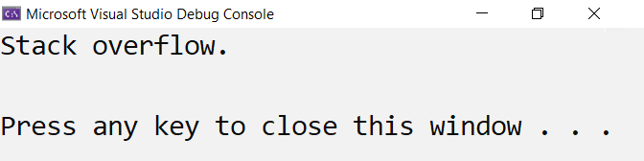
Infinite Recursion
Infinite recursion == a method calls itself infinitely
Typically, infinite recursion == bug in the program
The bottom of the recursion is missing or wrong
In C# / Java / C++ causes "stack overflow" error

Slide 22
Recursion Can Be Harmful!
When used incorrectly recursion could take too much memory and computing power
static long CalcFib(int number)
{
if (number <= 1)
{
return 1;
}
return CalcFib(number - 1) + CalcFib(number - 2);
}
Console.WriteLine(CalcFib(10)); // 89
Console.WriteLine(CalcFib(50)); // This will hang!

Slide 23
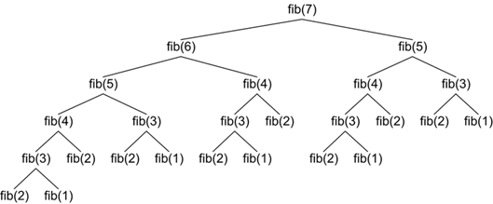
How the Recursive Fibonacci Calculation Works?
fib(n) makes about fib(n) recursive calls
The same value is calculated many, many times!

Slide 24
When to Use Recursion?
Avoid recursion when an obvious iterative algorithm exists
Examples: factorial, fibonacci numbers
Use recursion for combinatorial algorithms where:
At each step you need to recursively explore more than one possible continuation, i.e. branched recursive algorithms
24

Slide 25
Summary
…
…
…
Recursion: a method calls itself with different input
Pre-actions → recursion → post-actions
When to use recursion?
Branched recursive process
When to use iteration?
Linear recursive process

Slide 26
Questions?
Notes:
26

Slide 27

License
This course (slides, examples, demos, exercises, homework, documents, videos and other assets) is copyrighted content
Unauthorized copy, reproduction or use is illegal
© SoftUni – https://softuni.org
© Software University – https://softuni.bg
Notes:
27

